Slide 1
How Governance Became Unethical – and what to do about it
Professor Prabhu Guptara
www.prabhuguptara.blogspot.com
Follow on Twitter @PrabhuGuptara

Slide 2
Alexis de Tocqueville, 1805-1859

Slide 4
“There are many men of principle in both parties in America, but there is no party of principle”
Alexis de Tocqueville

Slide 5
“…there is no party of principle”
Alexis de Tocqueville

Slide 6
“There are many men of principle in both parties …”
Alexis de Tocqueville

Slide 7
American Values to the 18th century
Puritans, et. al.
“Cowboys”
Native Americans

Slide 8
American Values by the 19th century: two threats
Native American
“Cowboys”
Protestants
Rationalists, Deists
Southern Slavery

Slide 9
American Values at the start of the 21st century
Anti-Theists
Evangelical
Judeo-Christian
Evolutionists
Rationalists
“Cowboy”
Native American

Slide 10
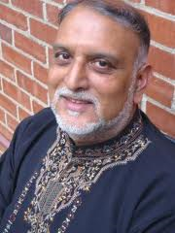
Vishal Mangalwadi

Slide 11
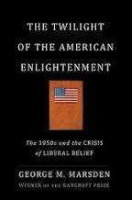
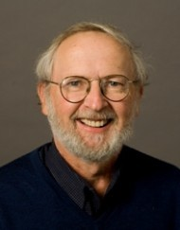

Slide 12
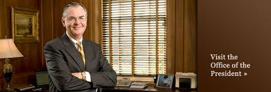
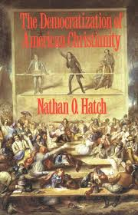
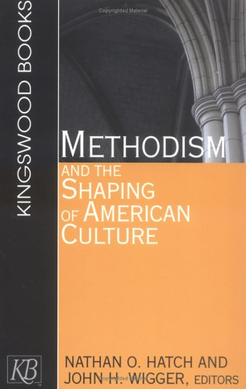

Slide 13
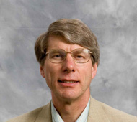
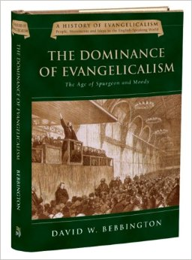
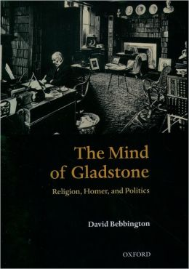

Slide 14
Transformations of the dominant consensus in the USA
No State Establishment of any religion, so competing varieties of Protestantism (good n explected…)
Then Protestant to “Christian”
“Christian” to “Judeo-Christian”
“Judeo-Christian” to “secular” (e.g. rejecting prayer in schools, the Ten Commandments from the 60s)
“secular” to “anti-theist” (in the 2000s)

Slide 15
Resulting High-Growth Hormones injected into the economy
1970s: US *DELINKS THE DOLLAR FROM GOLD* (enabling the value of the dollar to be more freely manipulated in the interests of growth)
from the 1980s, as natural demand starts drying up, our monetarist friends stimulate demand by artificial means, including persuading governments to put in place particular mechanisms that were more or less effective (FREDDIE MAC, FANNIE MAE)
from the 1990s, demand picked up worldwide as the result of the COLLAPSE OF THE BERLIN WALL AND THE OPENING OF RUSSIA, CHINA AND INDIA, making the whole world capitalist
But could we cope with this success?! 2.5 billion consumers and producers came into the economy, so we would have had historically unprecedented growth anyway, but various ways were found of boosting that growth even further, many of them unsound and dangerous. Any economy designed as ours is at present goes through booms and busts, and the greater the growth, the greater the booms and busts – so with these new mechanisms, the bust when it came was going to be one of the biggest yet – and that is what happened starting in 2007.

Slide 16
HIGH-GROWTH HORMONES (CONTINUED)
Leverage (120% mortgages, LTCM….)
Securitisation (“where’s the risk???”)
Speculation (Glass-Steagall versus Gramm-Leach-Bliley, 1999)
High Frequency Trading
…..
Leading to the current economic crisis which started in 2007, as well as the current political deadlock in the US

Slide 17
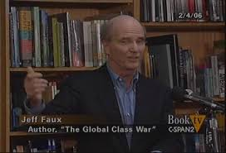
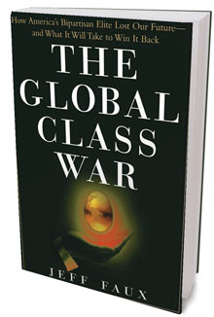
Note that the political gridlock is
a gridlock of interests, NOT one of policies (though that is the face it has to be given!) - see Jeff Faux’s The Global Class War: How America's Bipartisan Elite Lost Our Future)

Slide 18
Politics always trumps Economics
For economic renewal in the USA, political renewal is essential
But political renewal cannot take place without cultural renewal
For cultural renewal, Relational Thinking has much to offer everyone – whether ordinary Democrats, Republicans, or Uncommitted Citizens

Slide 22
www.relationalresearch.org

Slide 23
How Governance Became Unethical – and what to do about it
Professor Prabhu Guptara
www.prabhuguptara.blogspot.com
Follow on Twitter @PrabhuGuptara

